Slide 1
Design and Implementation the Native Web Browser and Server for Content-Centric Networking
CCNxCon 2015 Technical Report
Guoshun Nan*, Xiuquan Qiao*, Yukai Tu*,
Wei Tan#, Lei Guo*, Junliang Chen*
*Beijing University of Posts and Telecommunications, Beijing, China
#IBM T. J. Watson Research Center
2015.5.20
Contact: qiaoxq@bupt.edu.cn

Slide 2
Outline
Introduction
Related Work
Design Principles & Architecture Implementation
Experiments and Demonstration
Discussions

Slide 3
Introduction

Slide 4
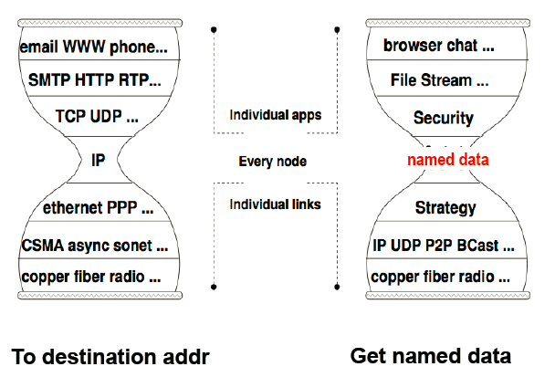

Application Provisioning Challenge in CCN
CCN network is completely different from the existing IP network. The existing application tools are mainly designed for existing network. It is obvious that enormous efforts are needed to rewrite or update current application tools running over IP to run over CCN.

Slide 5





Dominant Internet Application: WWW
World Wide Web (WWW) has become
one of the most popular Internet applications, with traffic
volume increasing due to the popularity of social networking,
cloud computing, and video streaming hosting.

Slide 6
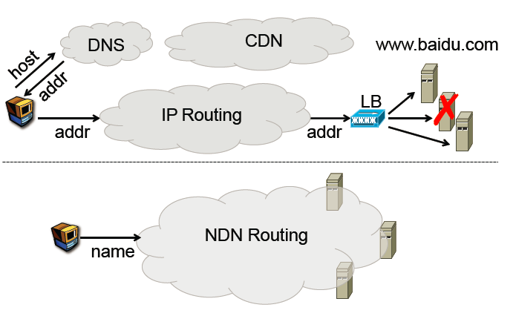
Great Changes of Web Application in IP and CCN
Load Balancer
CCN/
----from Prof. Beichuan Zhang of NDN Project

Slide 7
Motivations
Present Situation
The existing web servers are designed for the hypertext transfer protocol (HTTP) and IP-based Internet rather than CCN, and therefore can not communicate with CCN routers directly.
Unresolved Issue
How to effectively support the dominant browser-based web applications is a key to the success
of CCN.

Slide 8
Related work

Slide 9
Related work
HTTP-CCN Proxy/Gateway Approach
NDN.JS Approach

Slide 10
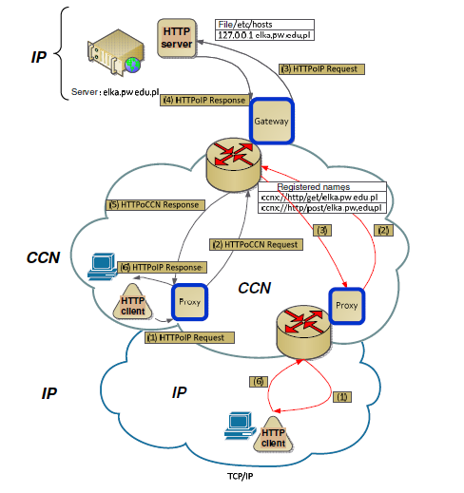
HTTP-CCN Proxy Approach (1)
Alcatel-Lucent Bell Labs

Slide 11
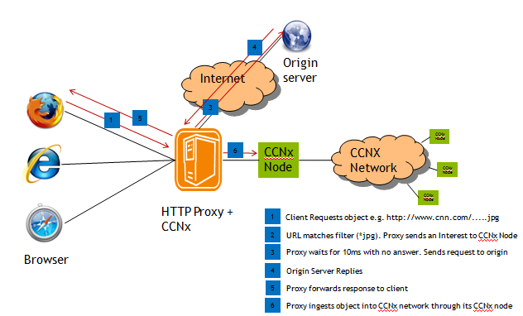
HTTP-CCN Proxy Approach (2)
Orange Labs

Slide 12
Advantages vs. Disadvantages
Advantages
The HTTP-CCN proxy approach has no influence on existing Web browsers and Web applications, which helps introduce the existing web traffic into CCN
Disadvantages
However, due to the protocol conversion cost and mismatch of HTTP with the CCN protocol, the proxy/gateway is not an efficient approach.

Slide 13
NDN.JS Approach
Background
Given the installation and configuration of ‘ccnd’ (a CCN router daemon) requires the understanding of the protocol design and significant skill in low-level system management.
The CCNx package is not well supported on some platforms, such as Microsoft Windows and iOS.
Motivation
Therefore, it is desirable to have a more ‘lightweight’ solution for bringing CCN services to average Internet users.

Slide 14
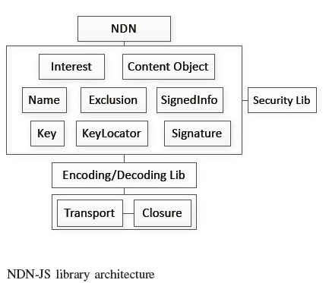
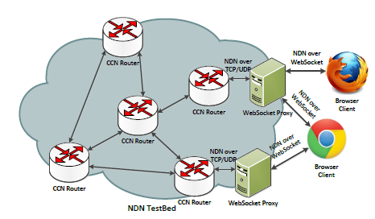
NDN.JS Approach
US UCLA NDN Project Group
Compared with HTTP/NDN proxy approach, NDN.JS tries to import the NDN function into web browser with Javascript library, which makes the web browser can identify NDN naming scheme in part of Tags.

Slide 15
Advantages vs. Disadvantages
Advantages
NDN.JS has the advantage of working with main stream browsers easily which some people might feel more comfortable with. In that case, the impact of NDN.JS on existing mainstream browsers is relatively less.
Disadvantages
But, since the kernel of existing browsers can not support NDN mechanism natively, some functions are limited. For example, how to render NDN ContentObjcets in Web browser is still an issue to be addressed by NDN.JS approach.

Slide 16
Our Motivations
The lack of native support for web applications will greatly hamper the wide adoption of CCN.
Therefore, to enable the Web browser and Web server to inherently support the extensive CCN-based applications, the complete Web browser and Web server dedicated to CCN is needed, which can fully embody the advantages of CCN.

Slide 17
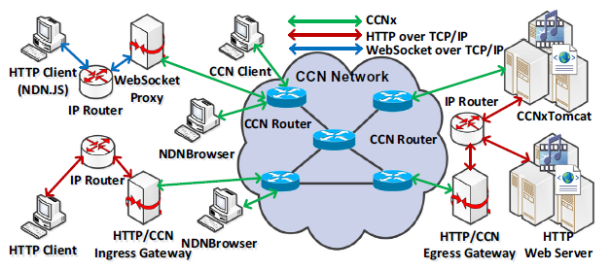
Native Approach: NDNBrowser and CCNxTomcat
Our native approach
Our native approach

Slide 18
Design Principles & Architecture Implementation

Slide 19
Design Principles of CCN-enabled Web Browser
The complete content fetching, loading and rendering support of CCNx URI in HTML,CSS and JavaScript
  Support for HTML, Images, CSS files and JavaScript files, Audio/Video tags in HTML5, JavaScript-based AJAX and developer-friendly API
The native function integration of web browser with CCN new features
  Support for Form submission
  Support for dynamically generated personalized content
  Support for friendly user interface

Slide 20
Technical approach of CCN Web Browser
We designed and developed an extended Web browser (i.e. NDNBrowser) based on open source WebKit to inherently support NDN-based web application
Some native NDN functions, such as fetching content from router caches or origin servers, fetching the latest version, have been embedded directly into the browser to fully support the seamless interactions between web browser and NDN network
Considering backwards compatibility and smooth network evolution, NDNBrowser is designed to enable content fetching by ’ccnx:/’ and ’http:/’ URI scheme for HTML, CSS and JavaScript simultaneously

Slide 21
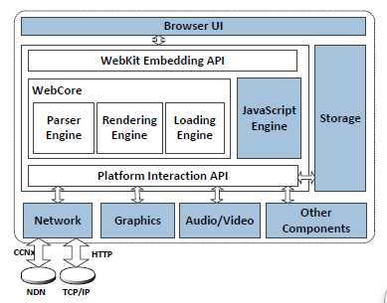
NDNBrowser: An Extension of Webkit
The blue components are extended

Slide 22
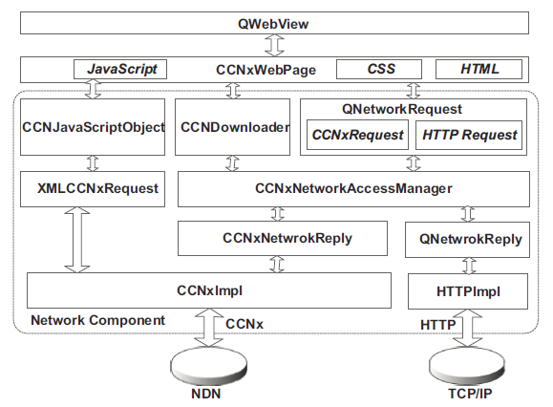
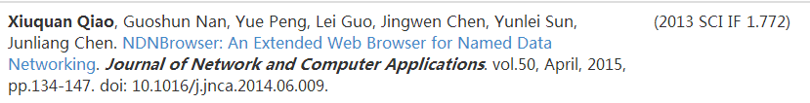
Component Architecture of NDNBrowser
For details

Slide 23
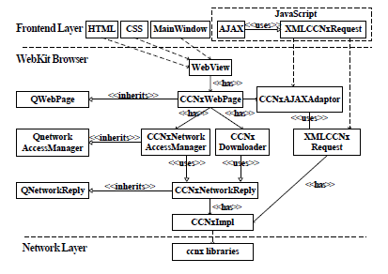
Implementation Structure of NDNBrowser

Slide 24
Design Principles of CCN-enabled Web Server
Seamless integration of the CCN protocol stack with web servers
Support both static and dynamic content resources
Support for push-type web application mode
Resource processing granularity at the named data chunk level
Cache management for the Servlet response
Supporting the smooth evolution of web applications

Slide 25
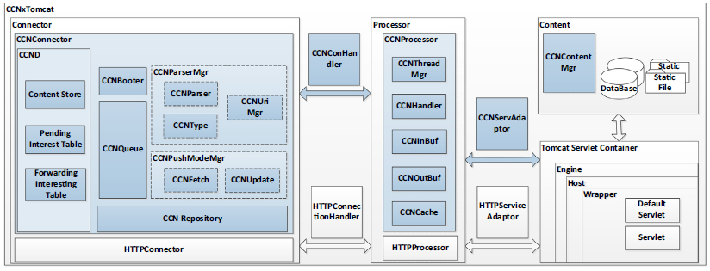
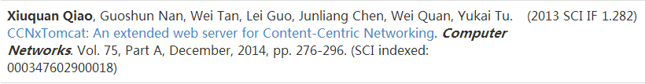
Architecture of CCNxTomcat
For details

Slide 26
Experiments and Demonstration

Slide 27
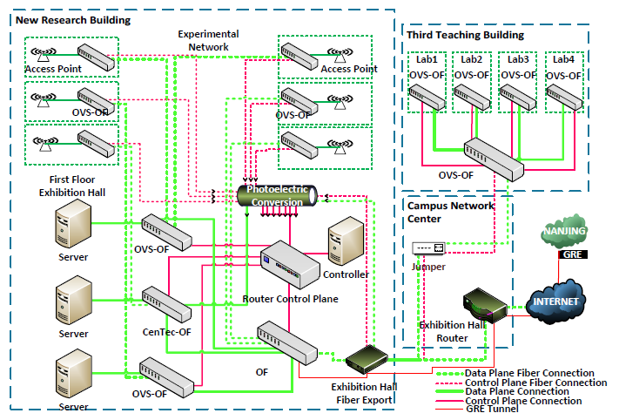
Future Internet Testbed of Our University

Slide 28
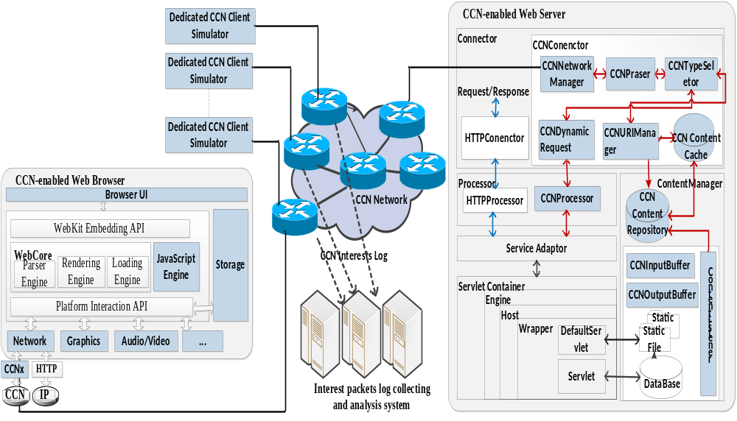
CCN-Enabled Web Application Platform

Slide 29
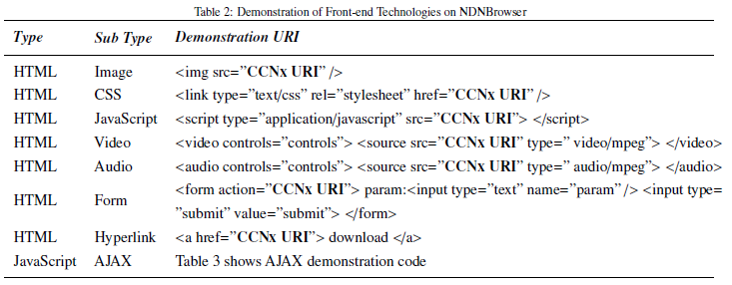
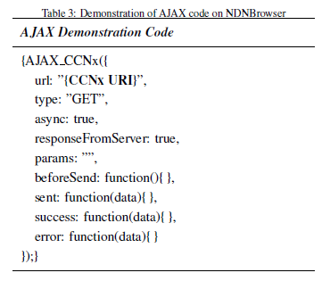
Function Test

Slide 30
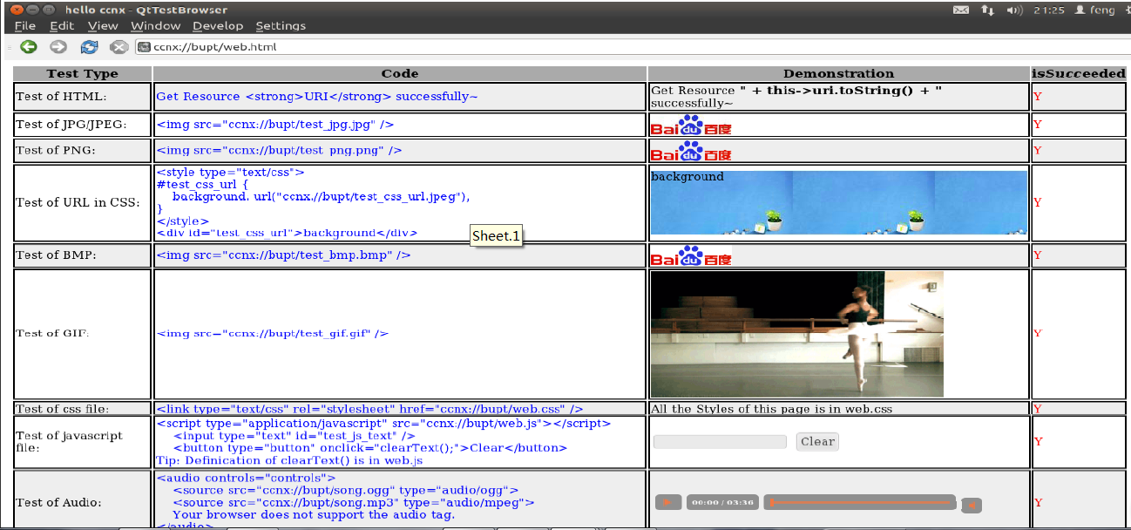
Function Test Results

Slide 31
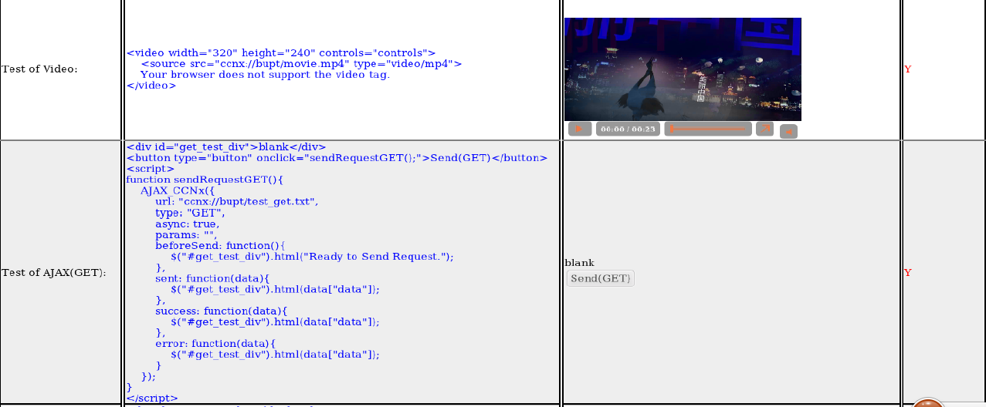
Function Test Results (Con.)

Slide 32
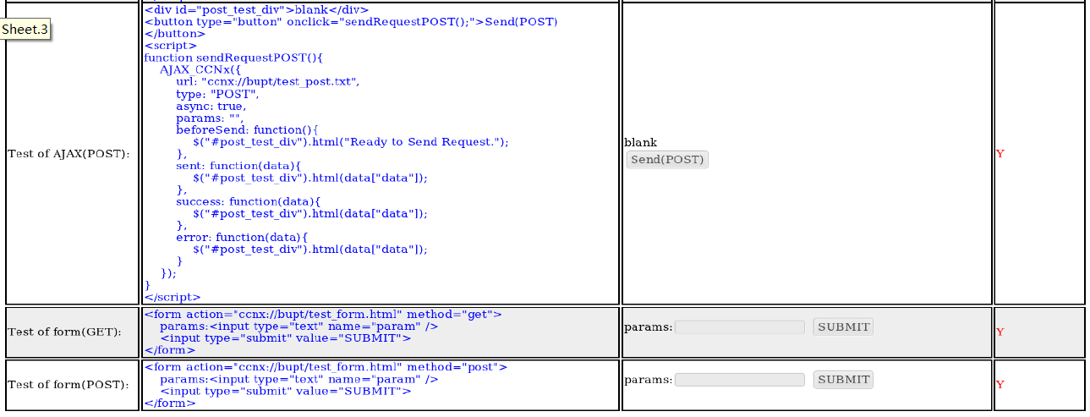
Function Test Results (Con.)

Slide 33
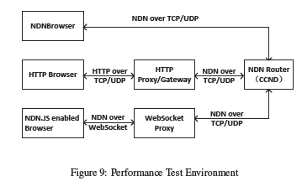
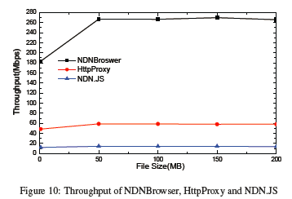
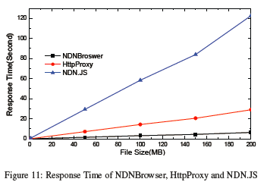
Performance Test of NDNBrowser

Slide 34
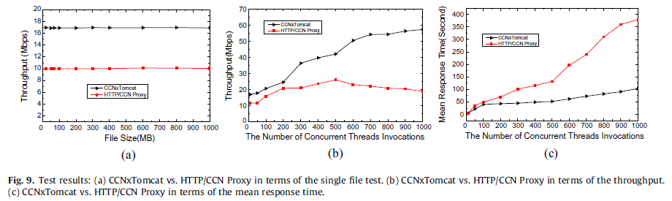
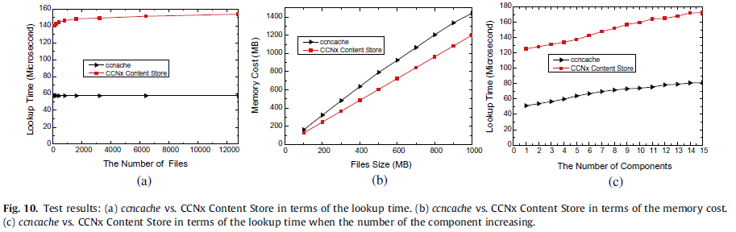
Performance Test of CCNxTomcat

Slide 35
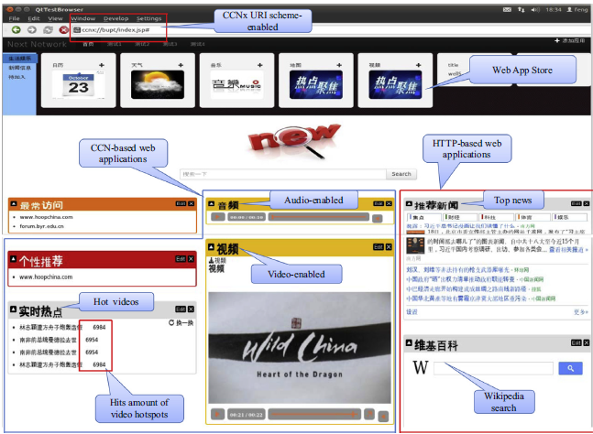
A Real CCN-enabled Web Application Case

Slide 36
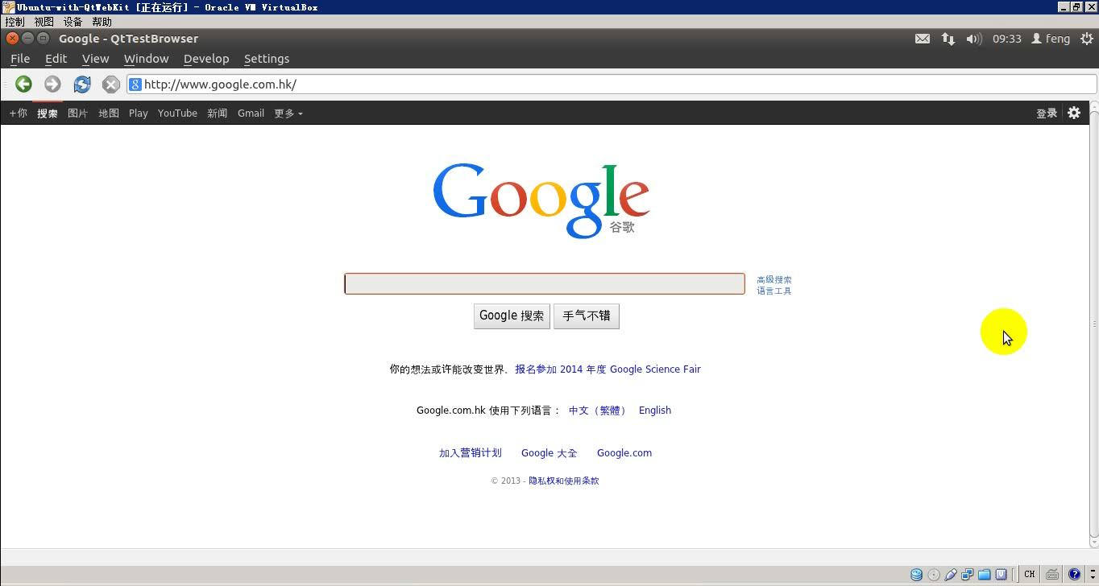
Demonstrations

Slide 37
Discussions

Slide 38
Challenge 1
Potential Mismatch with Existing Business Models
Two Important Features of CCN/NDN
  In-network Caching
  Interest Aggregation
Advantages
  Low Response Time
  Reducing the Duplicated Network Traffic
Disadvantages
  Content providers will be unaware of the actual usage of their contents throughout the network.
  This new model is misaligned with existing business models where advertising revenue is based on content hit count.

Slide 39
Challenge 2
Efficiently Supporting Diverse Application Types
The CCN/NDN is a pull-based network and is unfriendly for push-based applications.
Fortunately, the new version CCN implementation (CCNx 1.0) has improved this drawback in the protocol stack. In this new version, the CCN Interest packet message supports the optional payload, which can be used to carry user’s data.

Slide 40
Thanks!
Any Questions, Please Contact: qiaoxq@bupt.edu.cn

